Slide 1
In The Thick of It: LIVE-HCM Trial
with
Dr. Rachel Lampert
Professor of Medicine, Yale University
and
Dr. Andrew Wang
Professor of Medicine, Duke University

Slide 2
In The Thick of It
To broadly communicate new information about hypertrophic cardiomyopathy (HCM) to improve the understanding of the disease and the treatment of patients living with HCM.
To engage with diverse professionals in the field of HCM.
To promote ongoing and future collaborations in HCM-related research, education and clinical care.

Slide 3
Disclosures
Dr. Lampert: Medtronic (research grant, advisory board), Abbott/St Jude (research grant, honoraria), Boston Scientific, (research grant)
Dr. Wang: Bristol Myers Squibb (consultant; speaker); Cytokinetics (consultant); BioMarin (consultant)

Slide 4
Background
Benefits of exercise, physical and psychological, are well-described
Concern for risk of ventricular arrhythmia and sudden death has led to restriction of vigorous exercise for individuals with hypertrophic cardiomyopathy (HCM)
Prospective, comparative data are lacking on the safety of vigorous exercise for individuals with HCM

Slide 5
Study Objectives
To determine whether engagement in vigorous exercise, including competitive sports, is associated with increased risk for life-threatening ventricular arrhythmia and/or mortality, in individuals with HCM followed prospectively over three years

Slide 6
Study Methods
Inclusion criteria:
Diagnosis of HCM
OR
Genotype+, no LVH
(i.e. phenotype negative)
Exclusion criteria:
Conditions precluding exercise (including NYHA Class III or IV)
Syndromic, infiltrative disease
Inability to complete questionnaires (e.g. language or cognitive barriers)
Recruitment:
42 sites in US, UK, Canada, Australia, New Zealand
May 2015 – Feb 2019
Self-enrolled through patient advocacy organizations (HCMA, SADS) and physician notification
Diagnosis/eligibility confirmed via chart review, Echo Core Lab (Mayo Clinic)

Slide 7
Study Methods 2.
Exercise classification – Minnesota Leisure Time Activity Questionnaire
Vigorous: At least 1 activity with METS > 6 for > 60 hours/year
Moderate: All activities > 4 and < 6 METS for > 60 hours/year
Sedentary: Not meeting criteria for moderate or vigorous
Clinical data: Records obtained from sites or primary cardiologist
Outcomes and events: Participants surveyed every 6 months for occurrence of events
Endpoints: Adjudicated by events committee blinded to exercise classification:
Death
Resuscitated cardiac arrest
Syncope - definitely or likely arrhythmic or undetermined
Appropriate shock from an implantable cardioverter defibrillator, reviewed by two electrophysiologists

Slide 8
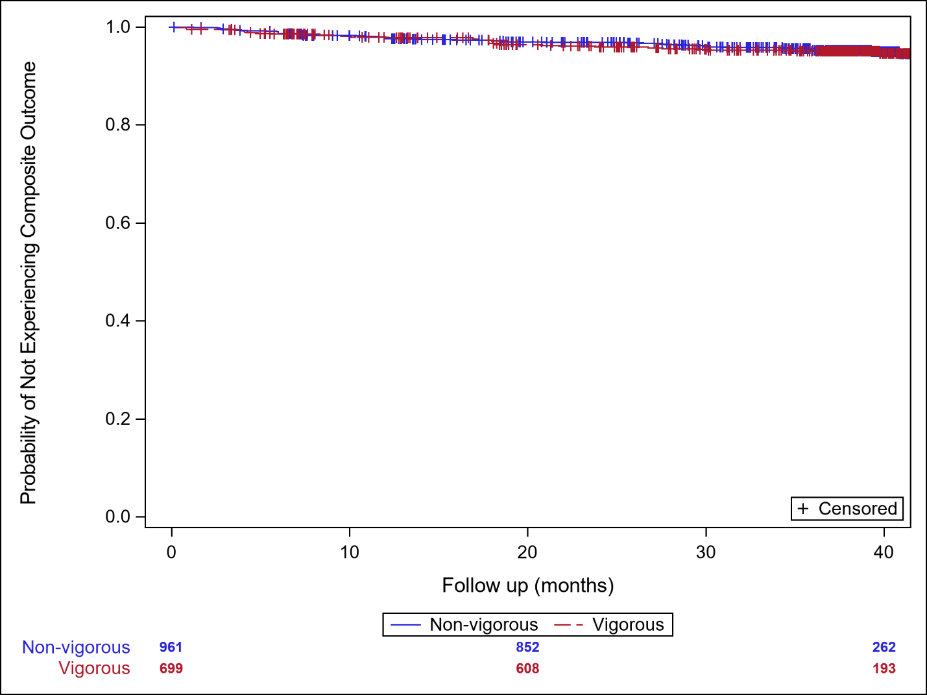
Results
Survival Free of Composite Endpoint:
Vigorous versus Non-Vigorous groups

Slide 9
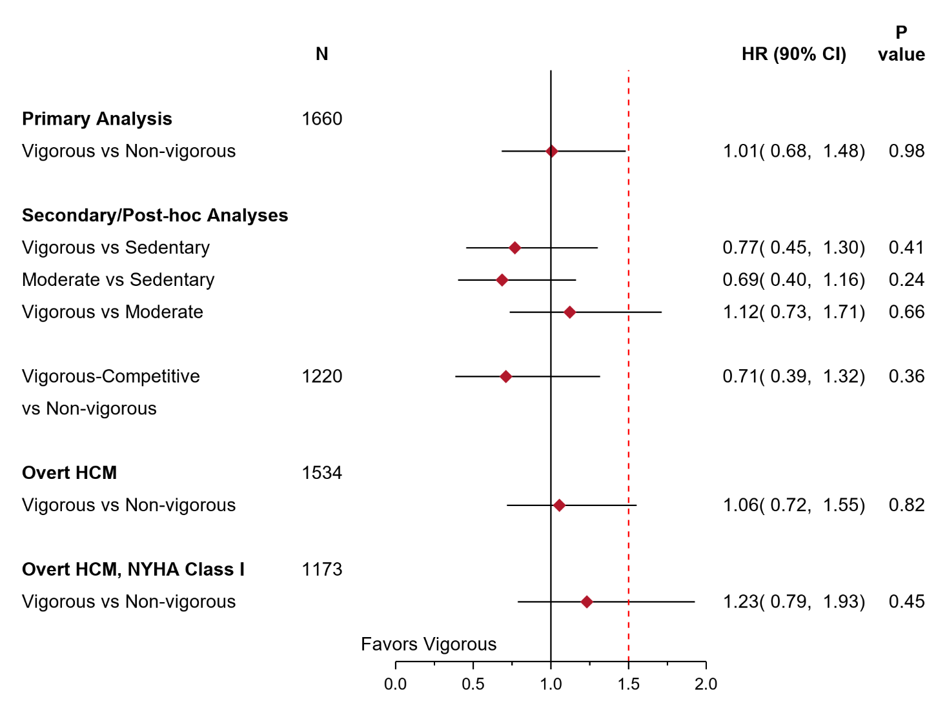
Results
Hazard Ratios for composite endpoint comparing
vigorous versus non-vigorous groups

Slide 10
Conclusions
In this prospective study of 1660 individuals with HCM or genotype-positive/phenotype-negative (8%), those engaged in vigorous exercise did not experience a heightened risk of death, cardiac arrest, appropriate ICD shocks or arrhythmic syncope compared to individuals engaging in low to moderate intensity physical activity.
Individuals who were participating in high-intensity competitive sports were also not at heightened risk.
Overall event rates were low, with < 5% experiencing the composite endpoint over 3 years

Slide 11
Conclusions
Post hoc analysis limited to those with overt HCM showed a similar HR although non-inferiority was not demonstrated based on the pre-specified boundary.
In neither the primary patient population, nor any subgroup comparison, was either vigorous or non-vigorous exercise shown to be safer (superior).
These data will inform discussions between patients and physicians regarding vigorous exercise participation, in the context of expert assessment and management of HCM, using an individualized shared decision-making framework.
These data do not support universal restriction of vigorous exercise in patients with HCM.

